Slide 1

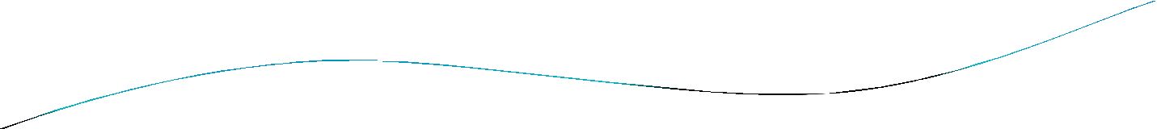


DEPARTMENT OF CIVIL ENGINEERING
UNIT-6
TOPIC - Centrifugal pump

Slide 2

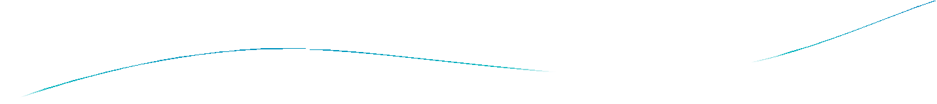
INTRODUCTION CONSTRUCTION CLASSIFICATION WORKING
HEADS LOSSES & EFFICIENCIES ADVANTAGE & DISADVANTAGE APPLICATION

Slide 3

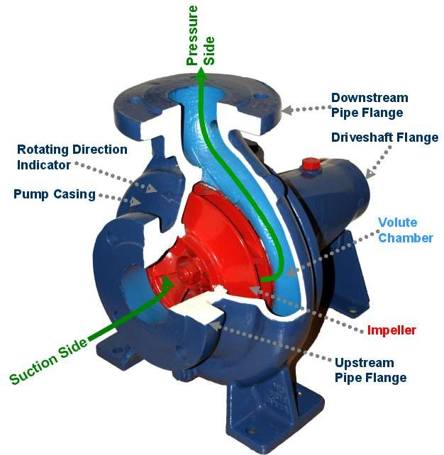

Slide 4

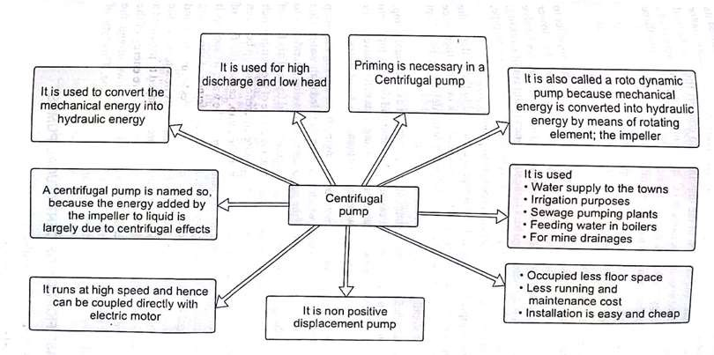
INTRODUCTION

Slide 5

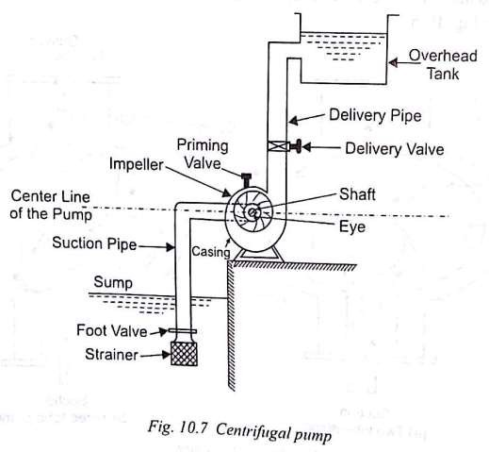
CONSTRUCTION
Sump
Strainer
Foot valve
Vanes
Impeller
Suction pipe
Delivery pipe
Casing
Delivery valve

Slide 6

CLASSIFICATION
According to working head
According to casing
According to number of entrances to the impeller
According to types of impeller
According to number of stages
According to shape of the vanes
According to disposition of shaft

Slide 7

According to working head
  Low head centrifugal pump – working head developed by these pumps is up to 15m.
  Medium head centrifugal pump – working head developed by these system is 15m<H<45m.
  High head centrifugal pump – working head developed by these pumps is more than 45m.

Slide 8

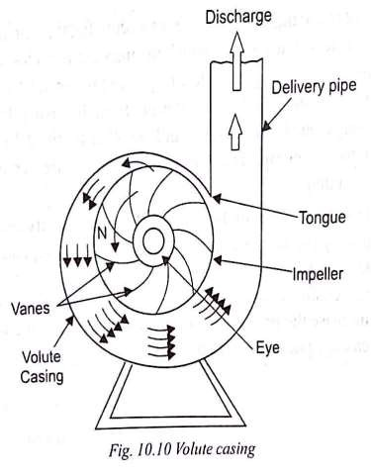
According to casing
Volute Casing
In this casing, the impeller is surrounded by the spiral casing.
The casing is such shaped that it’s c/s area gradually increases from tongue to delivery pipe.
Due to impact of the high velocity water leaving the impeller (shock losses), efficiency of conversion of K.E. into P.E. is very less.

Slide 9

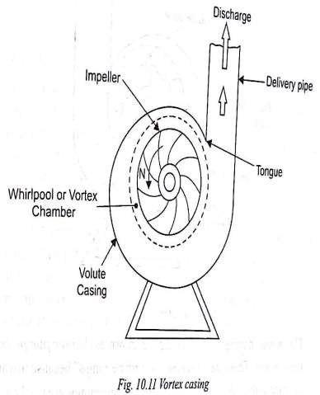
Vortex Casing
In this casing, an annular space known as vortex or whirlpool chamber is provided b/w the impeller and volute casing.
Liquid from the impeller flow with free vortex motion in vortex chamber where it’s velocity is converted into pressure energy.
It is more efficient than a volute casing.

Slide 10

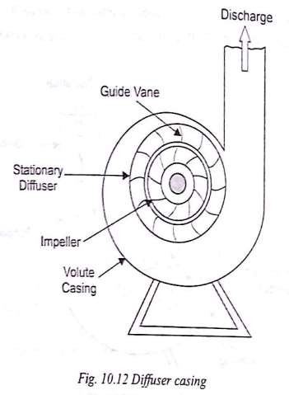
Diffuser Casing
In this casing , the guide vanes are arranged at the outlet of the impeller.
The guide vanes are shaped to provide gradually enlarged passage for flow of liquid.
The kinetic energy of the liquid coming out from the impeller is converted into the pressure energy during flow in guide vanes (increasing area).

Slide 11

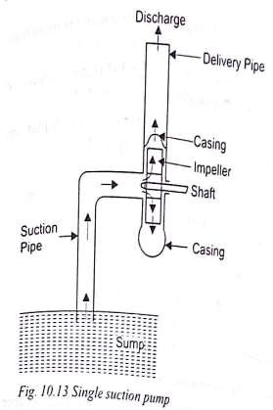
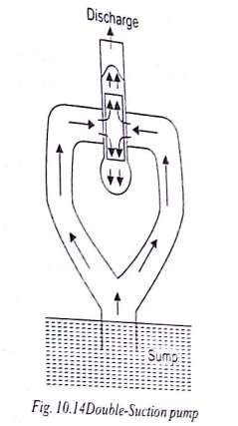
According to number of entrances to the impeller
Single suction pump
Liquid enters from a suction pipe to impeller only from one side.
Double suction pump Liquid enters to both the sides of impeller.

Slide 12

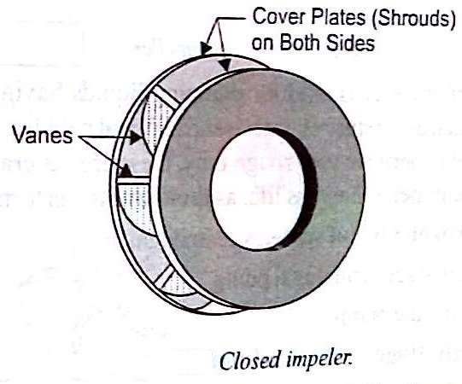
According to types of impeller
Closed impeller
if the vanes of the impeller are covered with plates on both sides, it is called a closed impeller. It is made of cast iron, stainless steel, cast steel, gun metal.

Slide 13

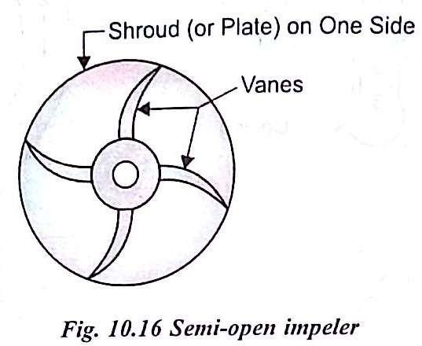
Semi open impeller
if the vanes of the impeller are covered with plate on one side, it is called semi open impeller. It has less number of vanes, but it’s height is more than that of closed impeller.

Slide 14

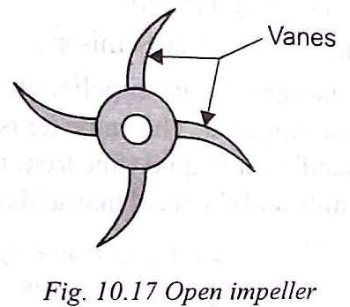
Open impeller
If the vanes of the impeller are without covered plate, it is called open impeller. These are generally made of forged steel. It has less life, as they have to perform very rough task.

Slide 15

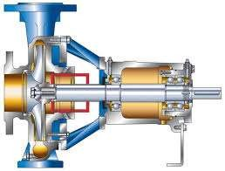
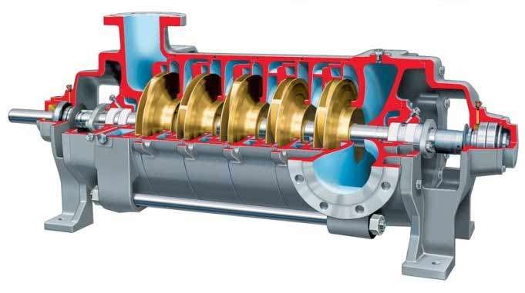
According to number of stage
Single stage
In a single stage pump, only one impeller is used on the shaft.
 Multi stage
In a multi stage pump, more than one impeller is used on the same shaft and enclosed in the same casing. It is used to raise high head.

Slide 16

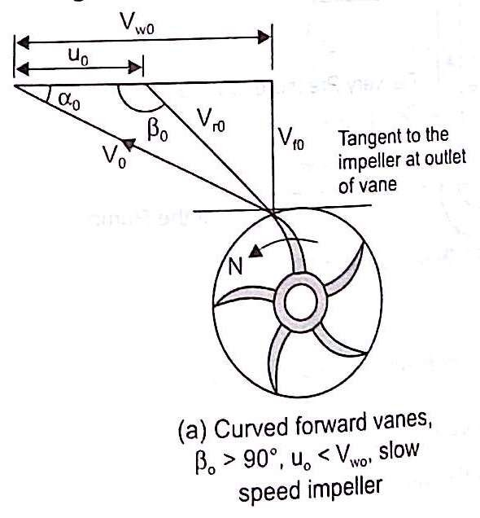
According to shape of the vanes
Curved forward vanes
The outlet tip of the vane is curved forward in the direction of rotation of the impeller. The impeller having such vanes is called slow speed impeller. This type of the impeller has low efficiency about 75%.

Slide 17

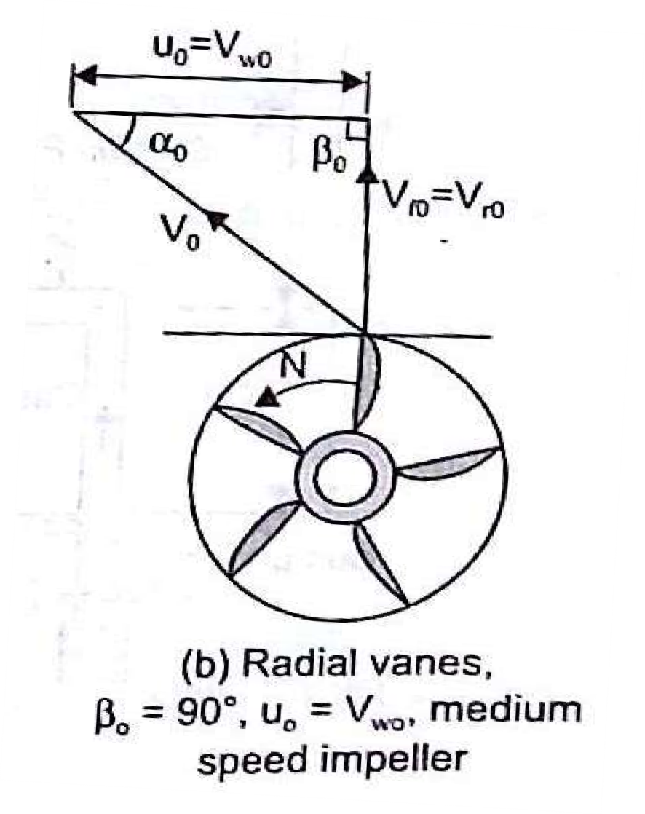
Radial vanes
These vanes have outlet tips in radial direction. The impeller having such vanes is called medium speed impeller. The efficiency of this type of impeller varies from 80% to 85%.

Slide 18

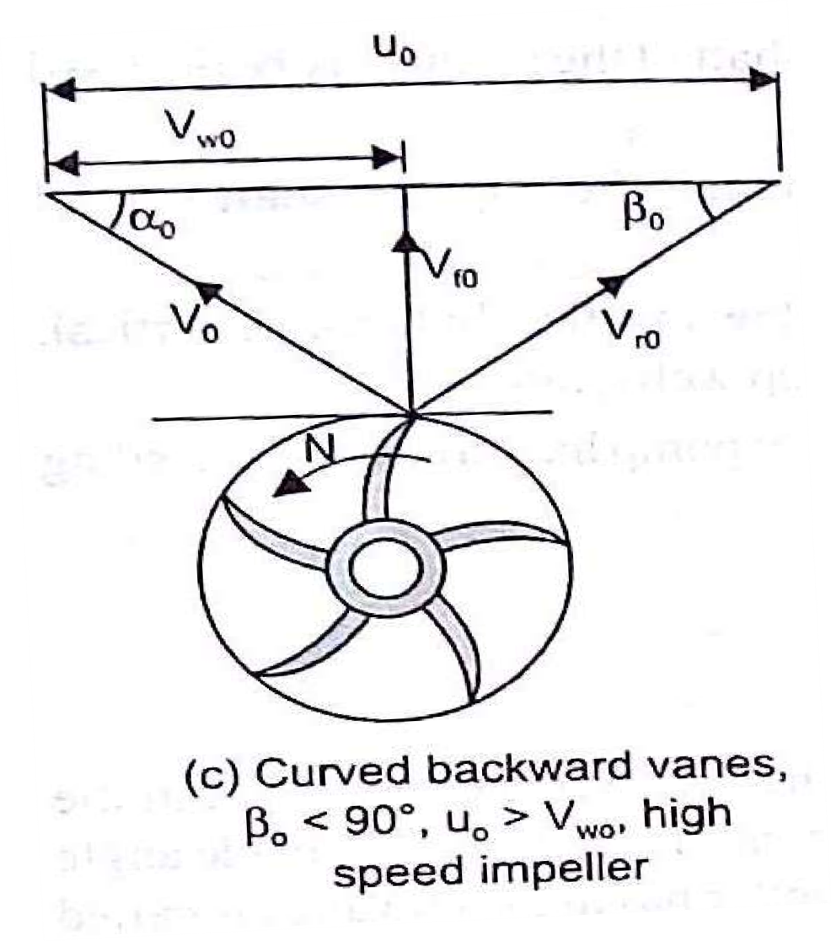
Curved backward vanes
The outlet tip of the vane is curved backward in the direction of rotation of the impeller. The impeller having such vanes is called fast speed impeller. This type of impeller gives highest efficiency about 85% to 90%.

Slide 19

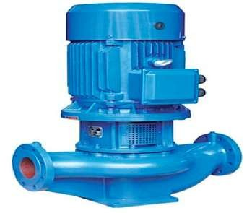
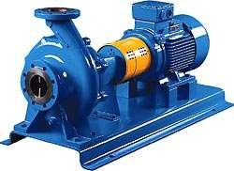
According to disposition of the shaft
Horizontal pump
In this type of pump, the impeller shaft is used horizontal.
Vertical pump
In this type of pump, the impeller shaft is used vertical.

Slide 20

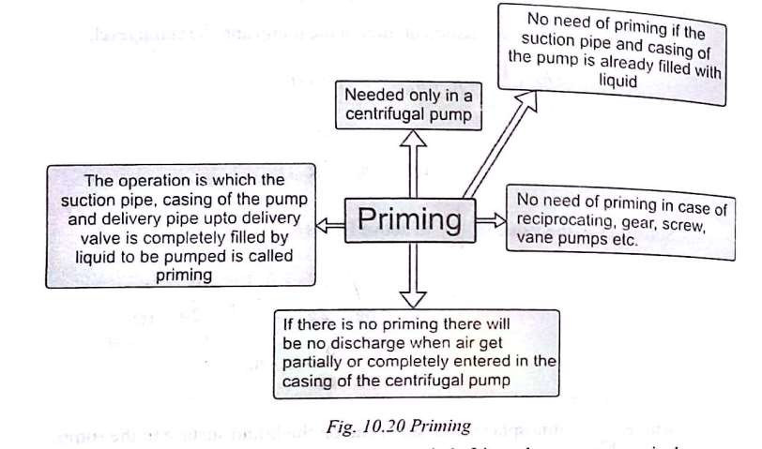
Priming

Slide 21

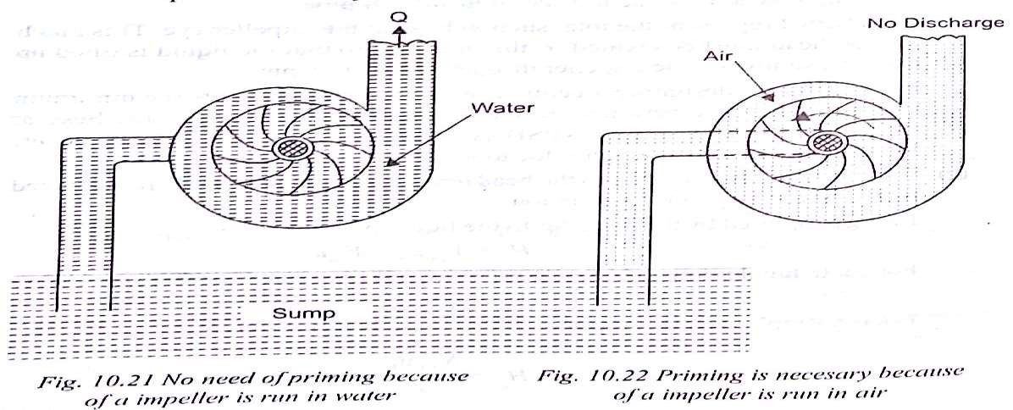
Necessity of priming

Slide 22

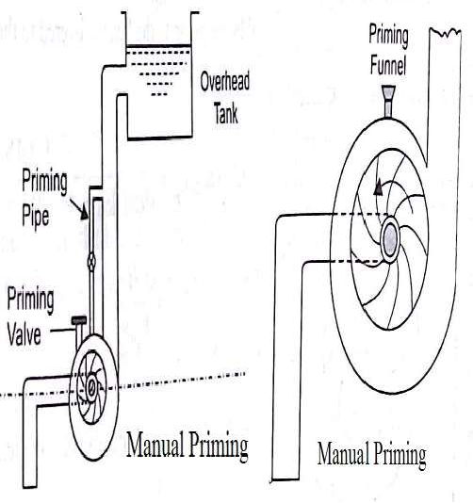
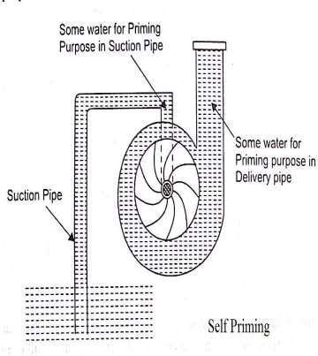
Methods of Priming
Manual Priming
Self Priming

Slide 23

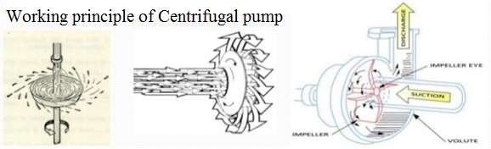
Working
Impeller in rotating motion forces water out towards the circumference due to centrifugal force effects.
Due to this, negative pressure gets generated at the centre of the pump so water is sucked from the sump via suction pipe which is connected to the pump.
The kinetic energy of high velocity water is converted into pressure energy because of diverging passage of casing.

Slide 24

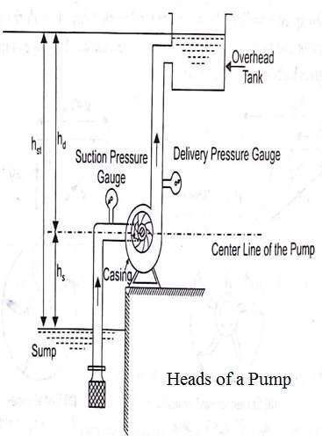
Heads
The heads of a pump may be expressed as:
Suction Head
Delivery Head
Static Head
Manometric Head
Total Head
Euler’s Head

Slide 25

Suction Head (h_{s}): It is the vertical distance b/w liquid levels in the sump and the centre line of the pump. Usually, it is kept 7 to 8 m to avoid cavitation.
Delivery Head (h_{d}): It is the vertical height of the liquid surface in the overhead tank to which the liquid is delivered above the centre line of the pump.
Static Head (h_{st}): It is the vertical distance b/w liquid levels in the sump and the overhead tank. It is the sum of suction head and delivery head. (h_{st}=h_{s}+h_{d}).
Manometric Head (H_{m}): The available head against which a centrifugal pump has to work is known as the manometric Head.
Total Head (H): It is the total head which has to be developed by a pump to deliver the liquid from the sump into the overhead tank.

Slide 26

 Euler’s Head (H_{e}): It is defined as the head developed by the impeller. It is denoted as H_{e}.
Losses
Energy losses in centrifugal pumps may be classified as follows:
Hydraulic Losses
Mechanical losses
Leakage Losses`

Slide 27

Hydraulic Losses: There are two types of hydraulic losses which may occur in a pump.
  Pipeline Losses: Major (due to friction) and minor (due to pipe bend) losses in pipes.
  Pump Losses: Eddy or shock losses, frictional losses in impeller, guide vane/diffuser, casing.
Mechanical Losses: Losses due to friction of main bearings and glands.
Leakage Losses: slipping back of part of liquid through the clearance between the impeller and casing due to pressure difference b/w inlet and outlet. Energy carried by these liquid is ultimately wasted and this loss of energy of liquid is known as leakage losses.

Slide 28

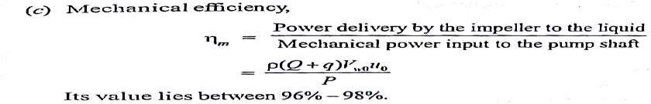
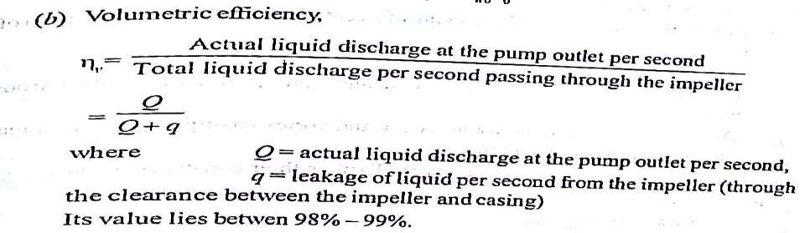
Efficiencies
 Mechanical Efficiency (Ƞ_{M}):
 Volumetric Efficiency (Ƞ_{V}):

Slide 29

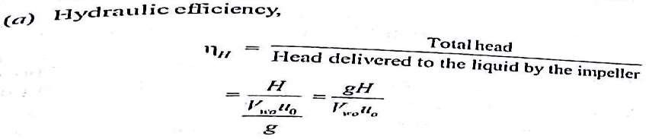
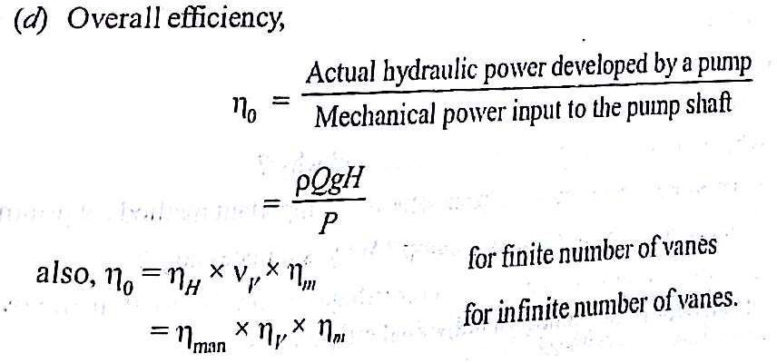
 Hydraulic Efficiency (Ƞ_{H})
 Overall Efficiency (Ƞ_{O})

Slide 30

Advantages
Small in size & space saving.
Output is very steady and consistent.
Easy for maintenance.
No danger creates if discharge valve is closed while starting.
Deal with large volume.
Able to work on medium to low head.
Able to work on medium to low viscous fluid.
Almost no noise

Slide 31

Disadvantages
Extra priming process requires.
Cannot be able to work on high speeds.
Cannot deal with highly viscous liquid.
Application
Agriculture and irrigation purpose.
Pumping of water in buildings.
Transfer raw material.

Slide 32
RECIPROCATING PUMPS

Slide 33

INTRODUCTION
Pumps are used to increase the energy level of water by virtue of which it can be raised to a higher level.
Reciprocating pumps are positive displacement pump, i.e. initially, a small quantity of liquid is taken into a chamber and is physically displaced and forced out with pressure by a moving mechanical elements.
The use of reciprocating pumps is being limited these days and being replaced by centrifugal pumps.

Slide 34

INTRODUCTION
 For industrial purposes, they
their
have high
become obsolete due to
initial and maintenance costs as compared to centrifugal pumps.
Small hand operated pumps are still in use that include well pumps, etc.
These are also useful where high heads are required with small discharge, as oil drilling operations.

Slide 35
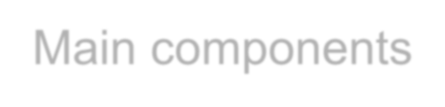
Main components
A reciprocation pumps consists of a plunger or a piston that moves forward and backward inside a cylinder with the help of a connecting rod and a crank. The crank is rotated by an external source of power.
The cylinder is connected to the sump by a suction pipe and to the delivery tank by a delivery pipe.
At the cylinder ends of these pipes, non-return valves are provided. A non-return valve allows the liquid to pass in only one direction.
Through suction valve, liquid can only be admitted into the cylinder and through the delivery valve, liquid can only be discharged into the delivery pipe.

Slide 36

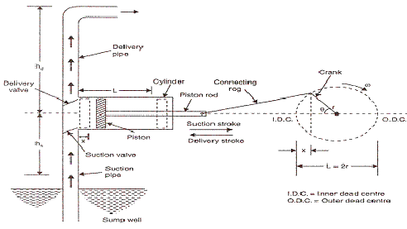

Slide 37

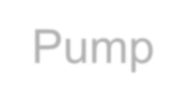
Working of Reciprocating Pump
When the piston moves from the left to the right, a suction pressure is produced in the cylinder. If the pump is started for the first time or after a long period, air from the suction pipe is sucked during the suction stroke, while the delivery valve is closed. Liquid rises into the suction pipe by a small height due to atmospheric pressure on the sump liquid.
During the delivery stroke, air in the cylinder is pushed out into the delivery pipe by the thrust of the piston, while the suction valve is closed. When all the air from the suction pipe has been exhausted, the liquid from the sump is able to rise and enter the cylinder.

Slide 38
Working of Reciprocating Pump
 During the delivery stroke it is displaced into the delivery pipe. Thus the liquid is delivered into the delivery tank intermittently, i.e. during the delivery stroke only.

Slide 39


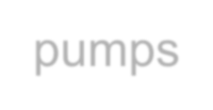
Classification of Reciprocating pumps
Following are the main types of reciprocating pumps:
According to use of piston sides
  Single acting Reciprocating Pump:
If there is only one suction and one delivery pipe and the liquid is filled only on one side of the piston, it is called a single-acting reciprocating pump.
  Double acting Reciprocating Pump:
A double-acting reciprocating pump has two suction and two delivery pipes, Liquid is receiving on both sides of the piston in the cylinder and is delivered into the respective delivery pipes.

Slide 40
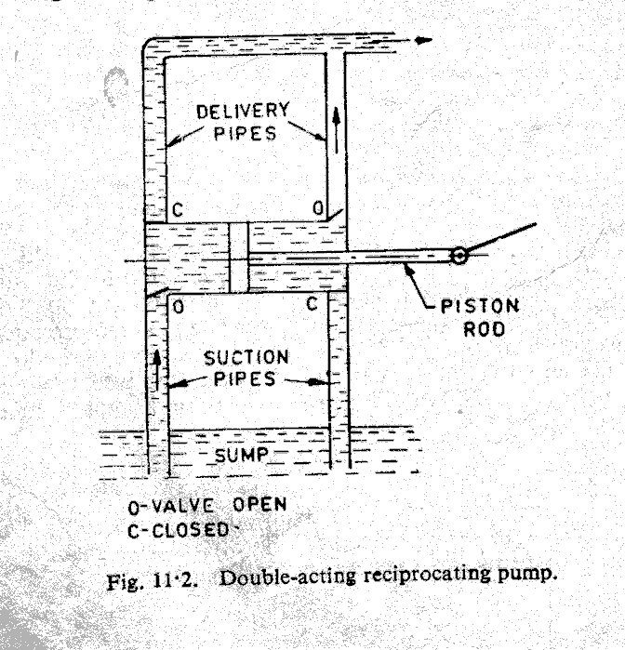

Slide 41
Classification of Reciprocating pumps
According to number of cylinder
Reciprocating pumps having more than one cylinder
are called multi-cylinder reciprocating pumps.
  Single cylinder pump
  Double cylinder pump (or two throw pump)
  Triple cylinder pump (three throw pump)
  There can be four-cylinder and five cylinder pumps also, the cranks of which are arranged accordingly.

Slide 42
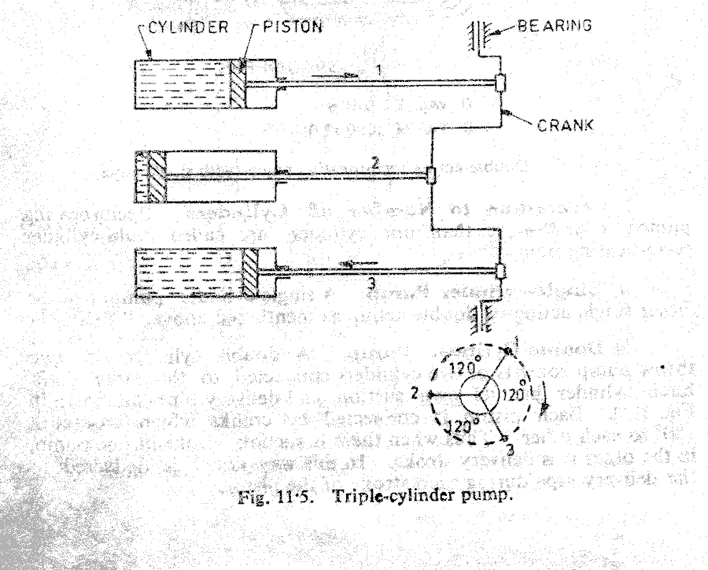

Slide 43


Discharge through a Reciprocating Pump
Let
A = cross sectional area of cylinder r = crank radius
N = rpm of the crank L = stroke length (2r)
Discharge through pump per second= Area x stroke length x rpm/60
N
Q_{th} = A × L ×
60
This will be the discharge when the pump is single acting.

Slide 44
Discharge through a Reciprocating Pump
Discharge in case of double acting pump
_{Q =} ⎡ ALN ₊ ( A − A_{P} )LN ⎤
Discharge/Second = th
⎥⎦
⎢⎣ 60 60
₌ (2A − A_{P} )LN
Q
th
60
Where, A_{p} = Area of cross-section of piston rod
However, if area of the piston rod is neglected
2 ALN
Discharge/Second =
60

Slide 45
Discharge through a Reciprocating Pump
Thus discharge of a double-acting reciprocating pump is twice than that of a single-acting pump.
Owing to leakage losses and time delay in closing the valves, actual discharge Q_{a} usually lesser than the theoretical discharge Q_{th}.

Slide 46
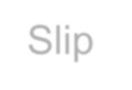
Slip
Slip of a reciprocating pump is defined as the difference between the theoretical and the actual discharge.
i.e. Slip = discharge
=
Theoretical discharge - Actual
Q_{th}. - Q_{a}
Slip%casnlailpso =be ^{Q}ex^{t}p^{h}re⁻ss^{Q}edªin^{ct}te×rm1s0o0f %age and
given by
^{Q}th
⎞
⎛
^{Q}act
⎟100 = (1 − C_{d} )100
= ⎜1 −
Q
⎝
th ⎠

Slide 47
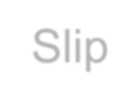
Slip
Slip Where C_{d} is known as co-efficient of discharge and is defined as the ratio of the actual discharge to the theoretical discharge.
percentage is known as volumetric efficiency of the pump. Its value ranges between 95---98 %. Percentage slip is of the order of 2% for pumps in good conditions.
C_{d} | = | Q_{a} / Q_{th}.
Value | of | C_{d} | when | expressed | in

Slide 48

Negative slip
It is not always that the actual discharge is lesser than the theoretical discharge. In case of a reciprocating pump with long suction pipe, short delivery pipe and running at high speed, inertia force in the suction pipe becomes large as compared to the pressure force on the outside of delivery valve. This opens the delivery valve even before the piston has completed its suction stroke. Thus some of the water is pushed into the delivery pipe before the delivery stroke is actually commenced. This way the actual discharge becomes more than the theoretical discharge.
Thus co-efficient of discharge increases from one and the slip becomes negative.

Slide 49
Problem-1: A single-acting reciprocating pump discharge 0.018 m³ /s of water per second when running at 60 rpm. Stroke length is 50 cm and the diameter of the piston is 22 cm. If the total lift is 15 m, determine:
Theoretical discharge of the pump
Slip and percentage slip of the pump
Co-efficient of discharge
Power required running the pump Solution:
L = 0.5 m
Q_{a} = 0.018m³ /s D = 0.22 m
N = 60 rpm H_{st} = 15 m

Slide 50
Solution:
(a)
Q = A× L × ^{N} = ^{⎛ π} D^{2 ⎞ LN}
⎜ ₄
th
60
⎝ ⎠
⎟ 60
Q_{th} = (π/4)x(0.22)²x(0.5x60/60)
Q_{th} = 0.019 m³ /s
(b) Slip = Q_{th} - Q_{a}
Slip = 0.019 – 0.018
= 0.001 m³ /s
Percentage slip = (Q_{th} - Q_{a})/ Q_{th}
= (0.019-0.018)/0.019
= 0.0526 or 5.26%

Slide 51
Solution:
C_{d} = Q_{a} / Q_{th}
= 0.018/0.019
= 0.947
Power Input
= ρ g H_{st}Q_{th}(Neglecting Losses)
= 1000 x 0.019 x 9.81x 15
= 2796 w or 2.796 kW

Slide 52

Comparison of Centrifugal and Reciprocating
Pumps
Centrifugal Pumps Reciprocating Pumps
Steady and even flow
For large discharge, small heads
Can be used for viscous fluids e.g. oils, muddy water.
Low initial cost
Can run at high speed. Can be coupled directly to electric motor.
Low maintenance cost. Periodic check up sufficient.
Compact less floors required.
Intermittent and pulsating flow
For small discharge, high heads.
Can handle pure water or less viscous liquids only otherwise valves give frequent trouble.
High initial cost.
Low speed. Belt drive necessary.
High maintenance cost. Frequent
replacement of parts.
Needs 6-7 times area than for centrifugal pumps.
Efficiency of low head pumps as low as 40 per cent due to the energy losses.
Torque not uniform.
Complicated construction. More number of spare parts needed.
8. Low head pumps have high
efficiency
Uniform torque
Simple constructions. Less number of spare parts needed

Slide 53

Agriculture. Chemical.
Desalination. Horizontal Drilling. General Industries. Mining.
Oil and Gas. Pulp and Paper. Sewer Cleaning. Steel.

Slide 54


